Slide 1
Game Technology
Lecture 7 – 28.11.2014
Dipl-Inf. Robert Konrad
Dr.-Ing. Florian Mehm

Slide 2
Preliminary timetable
Lecture No. | Date | Topic
1 | 17.10.2014 | Basic Input & Output
2 | 24.10.2014 | Timing & Basic Game Mechanics
3 | 31.10.2014 | Software Rendering 1
4 | 07.11.2014 | Software Rendering 2
5 | 14.11.2014 | Basic Hardware Rendering
6 | 21.11.2014 | Animations
7 | 28.11.2014 | Physically-based Rendering
8 | 05.12.2014 | Physics 1
9 | 12.12.2014 | Physics 2
10 | 19.12.2014 | Scripting
11 | 16.01.2015 | Compression & Streaming
12 | 23.01.2015 | Multiplayer
13 | 30.01.2015 | Audio
14 | 06.02.2015 | Procedural Content Generation
15 | 13.02.2015 | AI

Slide 3
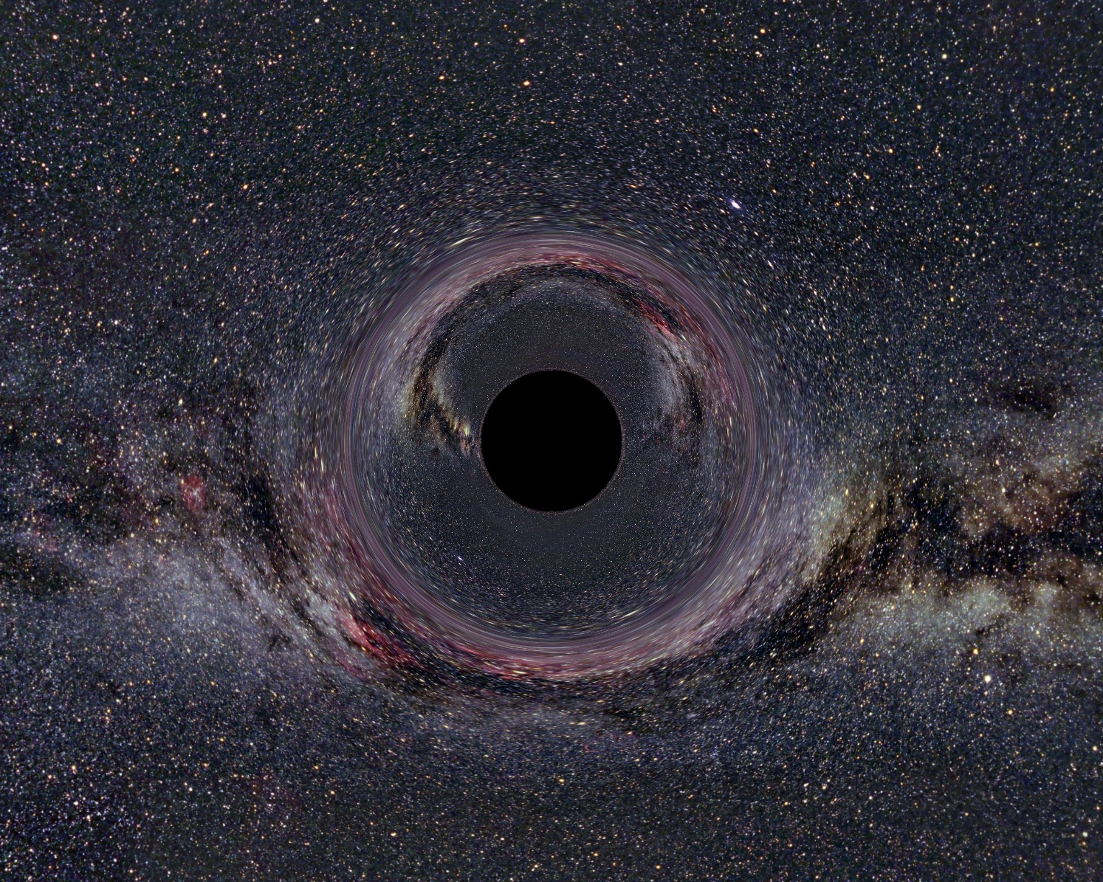
Physically Based Rendering
Notes:
From http://www.tempolimit-lichtgeschwindigkeit.de/galerie/galerie.html

Slide 4
Light
Starts from light source
Bounces around
Looses intensity with each collission
Eventually reaches the camera

Slide 5

Light Sources
Notes:
http://lights.helloenjoy.com

Slide 6
Point Lights
Defined by a position
and light color/intensity

Slide 7
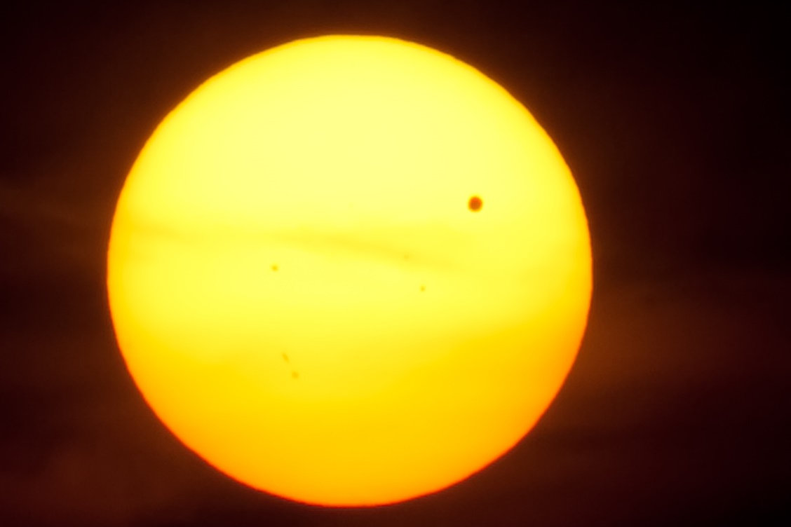
Directional Light
Just a direction
and light intensity/color

Slide 8

Area Lights
More light sources possible
Not supported by most game engines

Slide 9
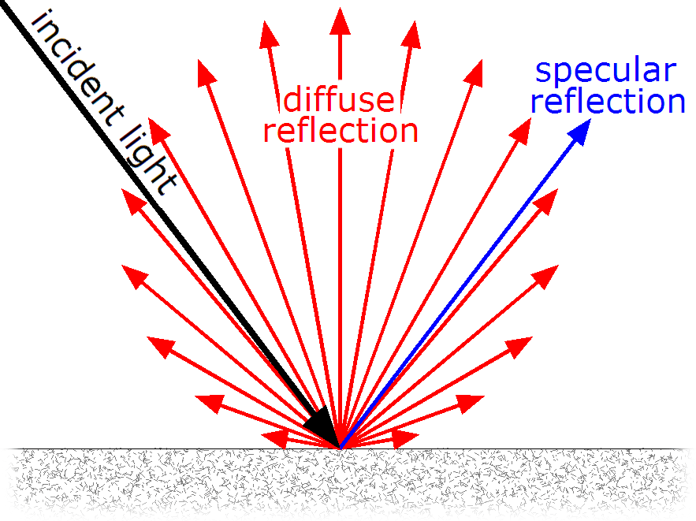
Bounces

Slide 10
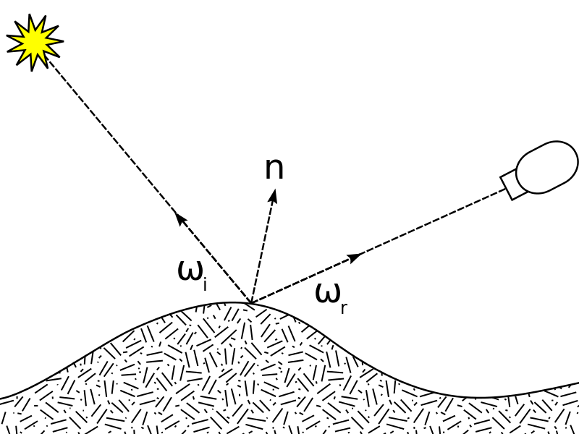
BRDF
Bidirectional reflectance distribution function
incoming light direction
outgoing direction (for example to the camera)
returns the ratio of reflected radiance

Slide 11
Path Tracing
foreach (pixel)
bounce around a lot
Use BRDF at each collision
Very slow
But useful to create reference images
and for prerendered lighting informations

Slide 12
Realtime Lighting
Consider only light rays from direct light sources
First bounce
Use shadow maps
Second bounce
Ignore further light bouncing
No reflections
No ambient light

Slide 13
Image Based Lighting
Put surroundings in cube map
Use for example path tracing to generate the cube map
Ignore lights, instead sample cube map
A cube map is only correct for one position
Ignores dynamic objects

Slide 14
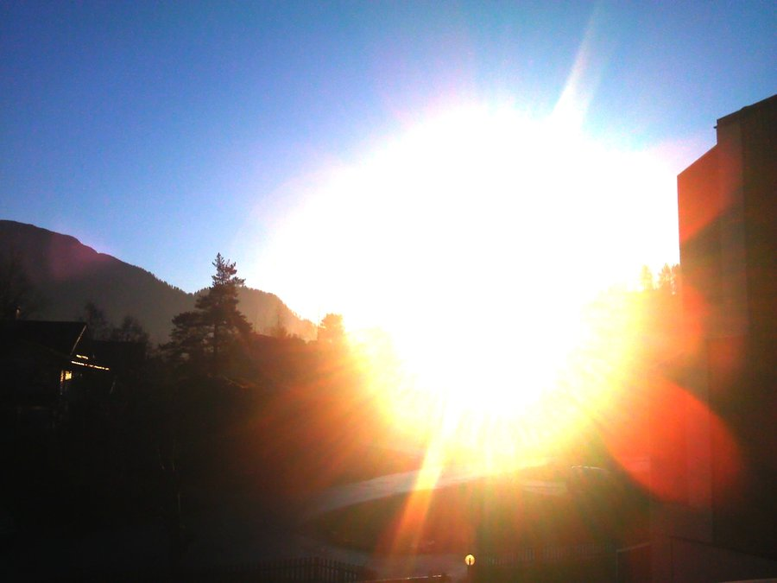
HDR
„High dynamic range“
Use more than 32 bits of data for one pixel

Slide 15
BRDF
Bidirectional reflectance distribution function
incoming light direction
outgoing direction (for example to the camera)
returns the ratio of reflected radiance

Slide 16
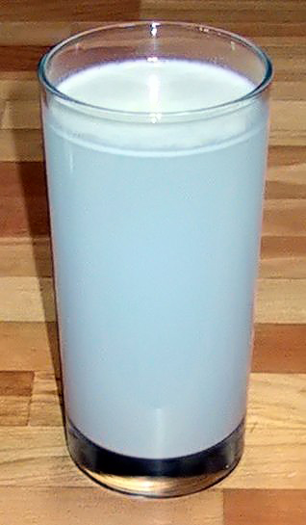
BRDF Shortcomings
Subsurface-Scattering
Wavelength dependence

Slide 17
BRDF
Only positive light

Slide 18
BRDF
Inverted

Slide 19
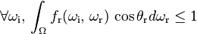
BRDF
Energy conserving

Slide 20
Phong Lighting
color = ambient + diffuse + specular

Slide 21
Phong Lighting
color = ambient + diffuse + specular

Slide 22
Gamma

Slide 23
sRGB
See Exercise 1
Transform textures to linear (pow 2.2)
Or use sRGB texture reading (also allows proper filtering)
Lighting calculations in linear space (gamma 1)
Then transform for sRGB (pow 1 / 2.2)
Notes:
See http://http.developer.nvidia.com/GPUGems3/gpugems3_ch24.html

Slide 24
Diffuse & Specular

Slide 25
Diffuse
Lambertian reflectance / Phong diffuse
I = L*N
Good enough for modern engines
Used for example in Unreal Engine 4

Slide 26

Specular

Slide 27

Brick
angle(normal, light) = angle(normal, camera)

Slide 28
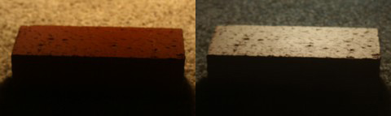
Brick
angle(normal, light) = angle(normal, camera)

Slide 29
Fresnel
Notes:
Real-Time Rendering, 3rd Edition, A K Peters 2008

Slide 30

Fresnel

Slide 31
Schlick Approximation
Schlick(spec, light, normal) = spec + (1 - spec) (1 - (light*normal))^5

Slide 32
Microfacet Model
Notes:
Real-Time Rendering, 3rd Edition, A K Peters 2008

Slide 33
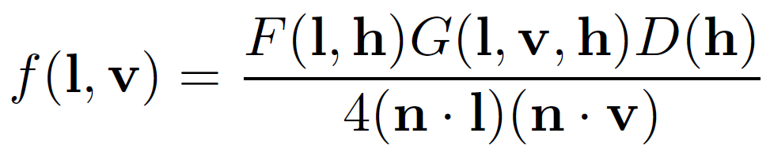
Microfacet BRDF

Slide 34
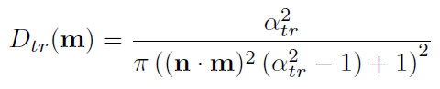
Normal Distribution
D(h)
Portion of microfacets pointing to h
Trowbridge-Reitz (GGX)
α: Roughness

Slide 35
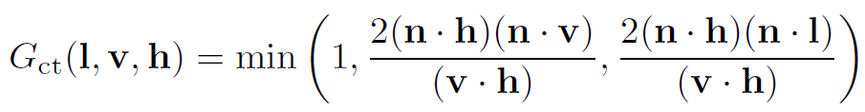
Geometry Factor
G(l, v, h)
Cook-Torrance:
Notes:
Real-Time Rendering, 3rd Edition, A K Peters 2008

Slide 36
Physically Based Rendering
In practice:
Gamma correction
Microfacet BRDF
Lots of Cube Maps

Slide 37
Polarization of Reflected Light
Specular Reflection
Polarization does not change
Diffuse Reflection
Polarization is randomized

Slide 38
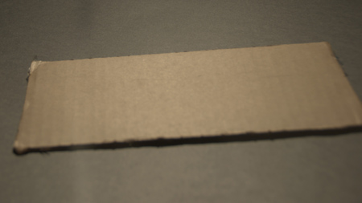
Cardboard
Notes:
Image from http://filmicgames.com/archives/547

Slide 39

Cardboard Diffuse

Slide 40
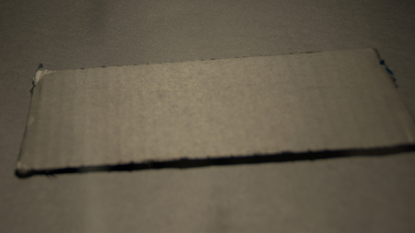
Cardboard Specular

Slide 41
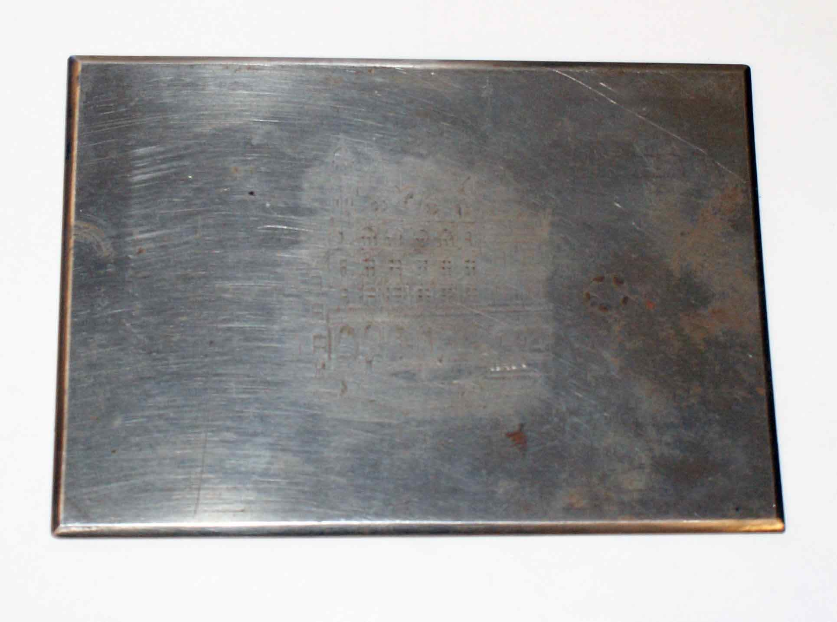
Metal

Slide 42
Metal Specular

Slide 43

Metal Diffuse

Slide 44
Metals and Dielectrics
Metals:
No diffuse
High Specular
Dielectrics
Diffuse
Low Specular
Note: Specular value is specified at low angles

Slide 45
Textures
Typical Setup:
Diffuse texture
Specular texture
Roughness texture
Normal Map

Slide 46
Incorporating Image Based Lighting
Precalculate Cube Maps
Lots of Cube Maps
Manually placed in level editor

Slide 47
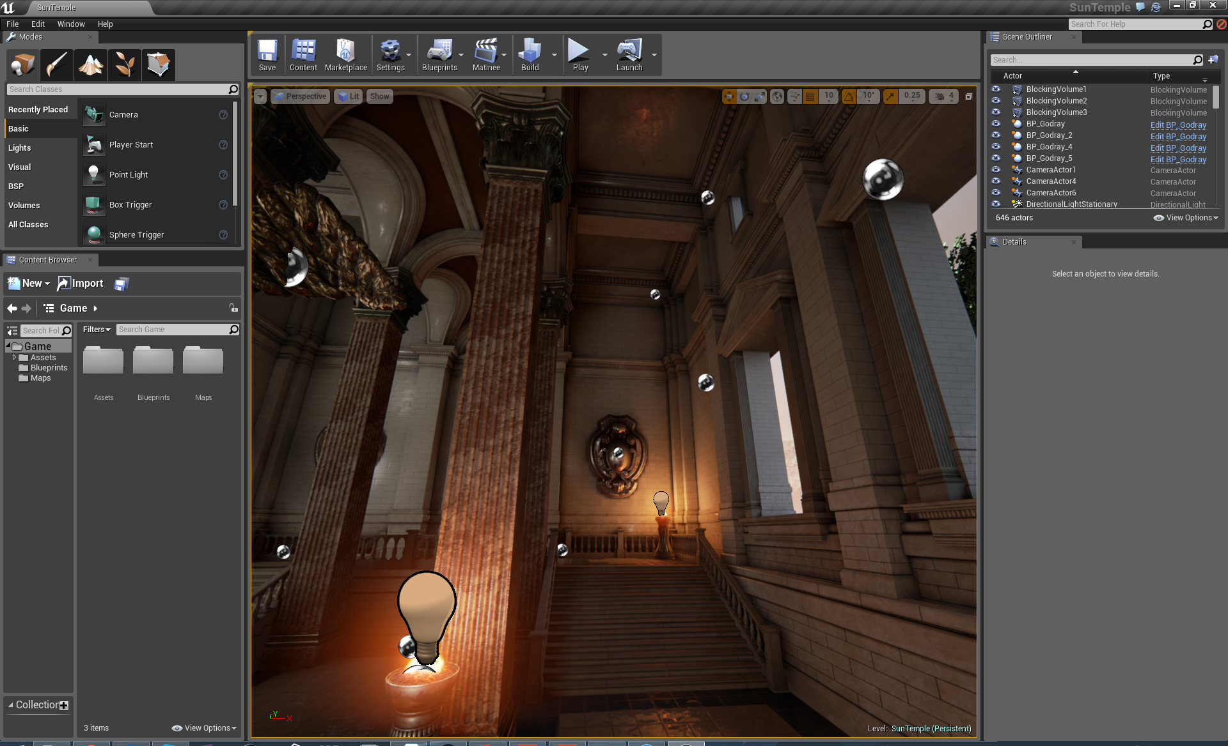
Cube Maps

Slide 48
Cube Maps
Can be interpolated
Which is a rough approximation
Can not capture dynamic objects

Slide 49
Reflection Rendering
As done in Unreal Engine 4, Killzone Shadow Fall,…
Deferred Rendering Pass
Raytrace depth buffer
If no hit
Interpolate local cube maps
If no hit
Use global cube map

Slide 50
Ambient Occlusion
Small notches are normally shadowed
Unless lit directly
Calculations need very exact light bounces

Slide 51
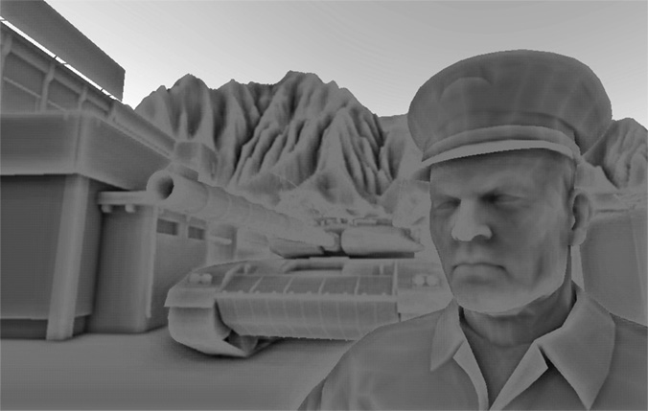
Screen Space Ambient Occlusion
Filter after rendering
Darken at sharp normal changes

Slide 52
Global Illumination
„Ambient light“
Spherical Harmonic Lighting
Voxel Cone Tracing
…

Slide 53
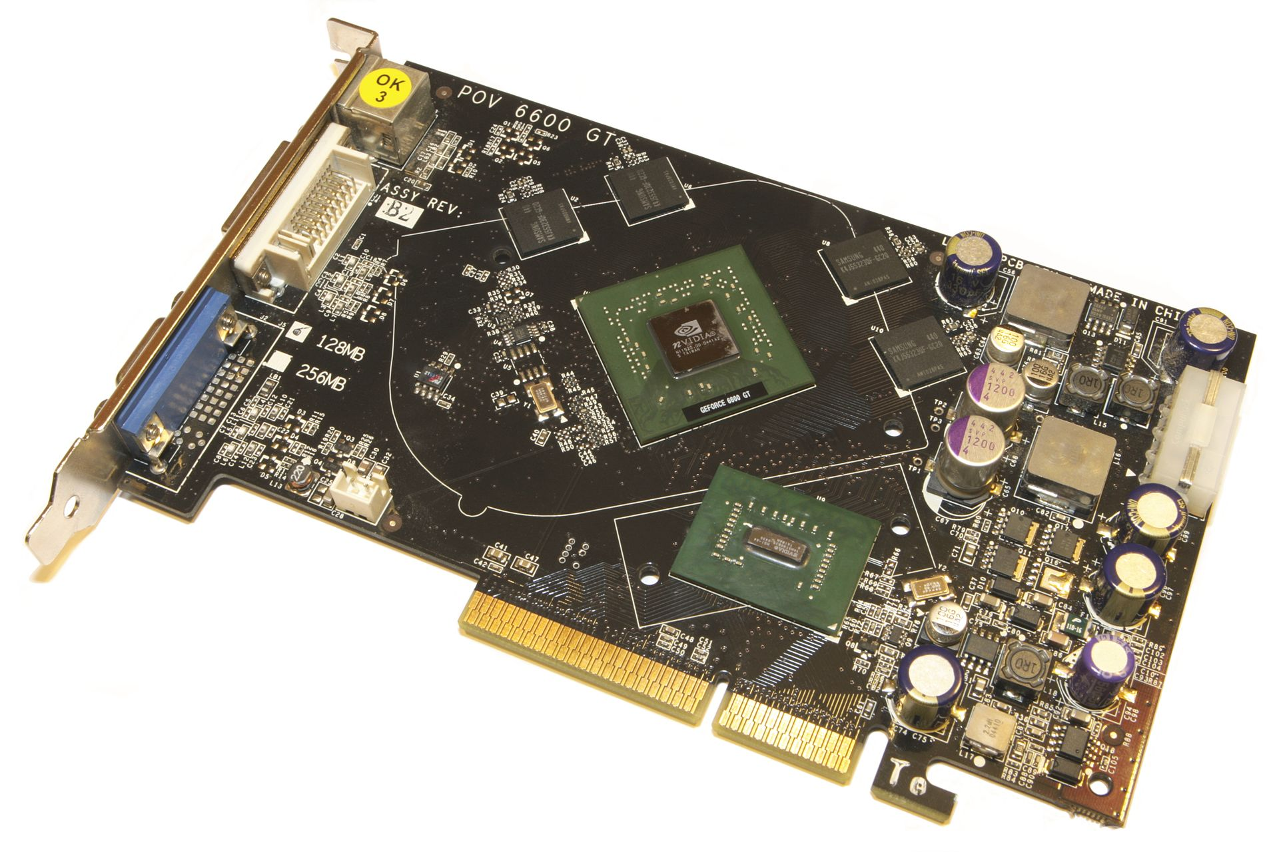
GPU Internals

Slide 54
Memory
Memory bandwidth is extremely important
Textures
Framebuffer
Depth Buffer
Memory access times not very important
Most data is streamed
Access times can be hidden by switching tasks

Slide 55
Memory
Gigantic discrepancy from low-end to high-end
GeForce 720 starts at 14.4 GB/s
PS4: 176 GB/s
GeForce 780 Ti: 336 GB/s

Slide 56
Vertex and Fragments Shaders
Run on the same hardware
Dynamically scheduled

Slide 57
Notes:
GCN Architecture Whitepaper

Slide 58
SMT
Also used in CPUs (Hyperthreading)
Switch to different thread when stalled (for example waiting for memory)

Slide 59
SIMD
Compiler can put calculations on multiple vertices/pixels in one instruction
Problem: Flow control
Wrong paths pseudo-executed
Can be efficient when all vertices/pixel in one pack take the same paths
Shader variants
„Typically when you create a simple surface shader, it internally expands into 50 or so internal shader variants” (Shader Compilation in Unity 4.5)

Slide 60
Parallelization
Small work packages can prevent parallelization
Performance dip for tiny triangles

Slide 61
CPU <-> GPU
Biggest performance trap
Minimize state changes
Minimize draw calls
Send little data to the GPU
If possible never read data from the GPU

Slide 62
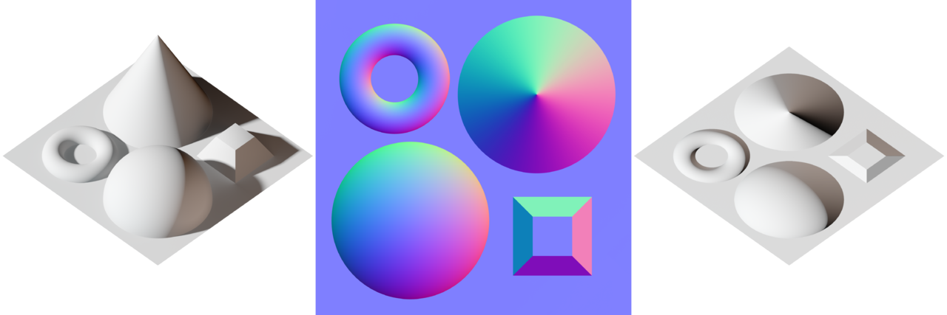
2.1 Normal Maps

Slide 63
2.2 Particles
Depth sorting
Particles can not intersect because they are flat -> sorting not much of a problem
Performance problem: Overdraw

Slide 64
2.3 Skeletal Animations
Quaternions because Quaternions
or
Euler angles because sufficient
Human joints are very restrictive

